Slide 1
Science Ahead
A Lower Secondary Science Course

Slide 2

CHAPTER 1 Introducing Science
Our daily lives are very closely related to science.
How do you think that the food we eat, the clothes we wear, the transport we take, or the devices we use are related to science? Is science always useful and beneficial?
What is the child doing?
Notes:
Lesson 1 (1 period; 40 minutes)
Chapter/Lesson trigger
Ask students why they study science.
Ask students the questions shown. Tell them that the child is using a virtual reality headset and that this is an example of useful science in our daily lives.
Ask students to mention more examples of such devices by looking around their classroom.

Slide 3
Chapter 1 Introducing Science
What Will You Learn in This Chapter?
Understand the meaning of science and technology.
Understand the attitudes, skills and processes involved in science.
Observe the safety rules in science laboratories.
Recognise the symbols representing different hazardous substances.
Understand the functions of different types of laboratory apparatus and how to use them.
Recognise the benefits, abuses and limitations of science and technology.
Notes:
Outline the learning outcomes of the chapter.

Slide 4
Chapter 1 Introducing Science
1.1 What Is Science?
1.2 What Are the Important Attitudes in Science?
1.3 What Are Skills and Processes in Science?
1.4 What Are Some Safety Rules in the Laboratory?
1.5 What Are Some Apparatus In the Laboratory?
1.6 Science and Technology

Slide 5
1.1 What is Science?
At the end of this section, you should be able to answer the following questions:
What is science?
What are the branches of science?
Identify some scientists who helped change the world.
Notes:
Ask students the questions shown to get them thinking about the importance of science in our daily lives.

Slide 6
1.1 What Is Science?
Science is the study of nature by making observations and doing experiments.
Geology
Science includes
Biology
Chemistry
Astronomy
Physics
Notes:
Discuss with students some branches of science and what each branch focuses on.
Explain to students why the different branches of sciences affect everyone.

Slide 7


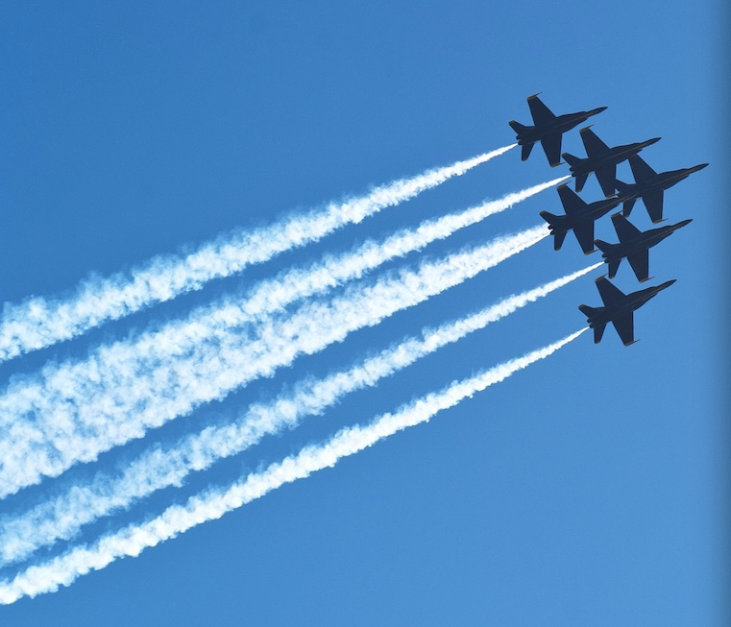

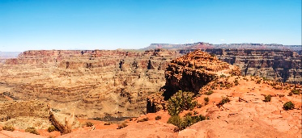

1.1 What Is Science?
Biology is the study of living things.
Astronomy is the study of stars, planets, moons and other objects, and phenomena in outer space.
Physics is the study of matter and its motion, energy, forces and their interactions.
Chemistry is the study of matter.
Geology is the study of the Earth’s structure.

Slide 8

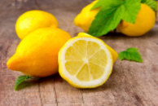
1.1 What Is Science?
How does science help us?
To understand the things around us
To solve problems
To train our minds to think logically and systematically
How are we able to move our bodies?
Why do lemons taste sour?
Notes:
Ask students to look at the things or events around them and see if they understand the science behind them.
Ask students to state the importance of science.
In pairs, ask students to share their answers in Think About It on Student Book p. 2.
Ask students what they know about the scientists shown and what these scientists have contributed to science.
Ask students to search the Internet to match the contributions that the scientists have made in Try It Out on Student Book p. 3.

Slide 9
1.1 What Is Science?
Key Points
Science is the study of nature by making observations and doing experiments.
Biology, chemistry, physics, geology and astronomy are some branches of science.
Science is closely related to our daily lives.
Notes:
Review the key points with students.

Slide 10
Chapter 1 Introducing Science
1.1 What Is Science?
1.2 What Are the Important Attitudes in Science?
1.3 What Are Skills and Processes in Science?
1.4 What Are Some Safety Rules in the Laboratory?
1.5 What Are Some Apparatus In the Laboratory?
1.6 Science and Technology

Slide 11
1.2 What Are the Important Attitudes in Science?
Curious
Open-minded
Co-operative
Fair and Objective
Sceptical
Humble
Perse-verance
Integrity
Notes:
Lesson 2 (1 period; 40 minutes)
Lesson trigger
Discuss with students the importance of these attitudes.
Ask students if they have these attitudes.
Ask students to talk about the attitude that is the most challenging for them.

Slide 12
1.2 What Are the Important Attitudes in Science?
At the end of this section, you should be able to answer the following questions:
What are some positive attitudes in the study and practice of science?
Who is Jane Goodall and what is her contribution to science?
Notes:
Ask students the questions shown to get them thinking about some important attitudes in science.
Ask students to read Try It Out on Student Book p. 4, about the story of Jane Goodall, a British scientist.
Ask students to discuss in small groups and share their answers with the class:
What are the positive attitudes that Jane Goodall has that allowed her to succeed in her study on wild chimpanzees?

Slide 13
1.2 What Are the Important Attitudes in Science?
Key Point
Curiosity, perseverance, open-mindedness, healthy scepticism, humility, integrity, and being co-operative, fair and objective are some positive attitudes to have in the study and practice of science.
Notes:
Review the key point with students.

Slide 14
Chapter 1 Introducing Science
1.1 What Is Science?
1.2 What Are the Important Attitudes in Science?
1.3 What Are Skills and Processes in Science?
1.4 What Are Some Safety Rules in the Laboratory?
1.5 What Are Some Apparatus In the Laboratory?
1.6 Science and Technology

Slide 15
1.3 What Are Skills and Processes in Science?
Observing
Using apparatus and equipment
Comparing
Classifying
Communi-cating
Inferring
Verifying
Making hypotheses
Predicting
Analysing
Investigating
Problem-solving
Notes:
Lesson 2 (1 period; 40 minutes)
Lesson trigger
Lead students to recognise that skills and processes are very important for the study and practice of science.
In pairs, ask students to explain one of the science process skills.

Slide 16
1.3 What Are Skills and Processes in Science?
At the end of this section, you should be able to answer the following questions:
What are skills and processes in science?
What are the steps in planning an investigation?
How do we test our hypothesis?
Notes:
Ask students the questions shown to get them thinking about the skills and processes needed to study and practice science.

Slide 17

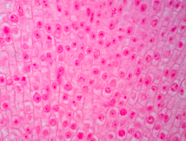
1.3 What Are Skills and Processes in Science?
OBSERVING
Observing is the skill of using the senses to find out about things or what is happening.
We observe with our senses and/or with the help of instruments (thermometers, microscopes and telescopes).
What tool can help us see these structures in a plant leaf?
What tool can help us know the temperature of the tea?
Notes:
Ask students to name the senses we have.
Ask students to name other instruments besides thermometers, microscopes and telescopes, that can help us to observe things.
Ask students to share their answers in pairs for Try It Out on Student Book p. 5.

Slide 18
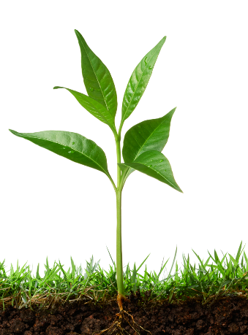
1.3 What Are Skills and Processes in Science?
COMMUNICATING
Communicating is a skill that involves sending and receiving information.
In what forms can we present the information on the growth of a plant?
Notes:
Ask students how they communicate with one another.
Guide students to think of ways in which scientists can present their data.
Ask students to answer Try It Out on p. 6.

Slide 19

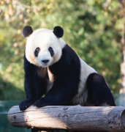
1.3 What Are Skills and Processes in Science?
INFERRING
Inferring is the skill of drawing conclusions from observations or information gathered.
The conclusions that we draw by inferring are called inferences.
Is her baby brother likely to have curly hair?
Is this animal a mammal?
Notes:
Explain to students what inferring is.
In groups of 3-4, ask students to discuss their answer in Try It Out on Student Book p. 7.
Additional support for struggling learners
Ask students to make inferences of the following scenarios:
Andy keeps looking at the clock in his classroom. He seems uneasy. After two minutes have passed, the teacher dismisses the class. He immediately runs to the toilet. Why?
Jack looks at his homework with a deep sigh, then crumples the paper and tosses it into a dustbin. Why?

Slide 20

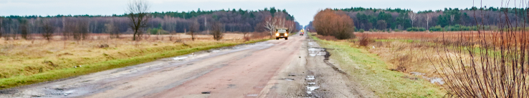
1.3 What Are Skills and Processes in Science?
MAKING A HYPOTHESIS
Making a hypothesis is the skill of providing a tentative explanation for an observation or phenomenon that can be tested through an investigation.
The puddles of water take a longer time to dry up on a cool day than on a hot day. What is your hypothesis?
Notes:
Describe to students what making a hypothesis is.
What do you do after you make a hypothesis?
Guide students to recognise why scientists make hypotheses.
Enrichment for advanced learners
Have students make hypotheses using the following scenarios.
An iron nail is placed in an open test tube. Another iron nail is placed in a test tube filled with 10 ml of water. After one month, the iron nail soaked in water has much more rust than the other nail.
Alcohol on your skin feels cooler than water.

Slide 21
1.3 What Are Skills and Processes in Science?
Make an observation
Make a hypothesis
Test the hypothesis
Does the result of the test support the hypothesis?
Yes: Accept the hypothesis
No: Make a new hypothesis
Notes:
Outline the steps for making a hypothesis in the flow chart showing the scientific method.
Ask students to make a hypothesis about fine sugar and rock sugar using the scientific method flow chart.

Slide 22
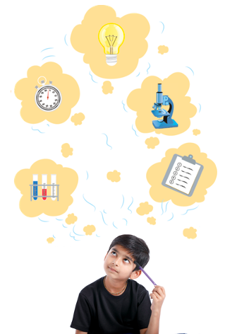
1.3 What Are Skills and Processes in Science?
PLANNING AN INVESTIGATION
What do we want to find out when we plan investigations in the study of science?
What do we need to ask when we plan an investigation?
Notes:
Ask students the questions shown.
Have students identify the skills involved in planning an investigation.

Slide 23
1.3 What Are Skills and Processes in Science?
Steps in Planning an Investigation
1
Ask a question or make a hypothesis for investigating.
2
Identify the variables involved. Which variables should be changed? Which variables should be kept constant?
3
Decide on the measurements or observations to be made and how to make and record them.
4
Decide on the materials or apparatus required for the investigation.
5
Decide on the steps or procedure of the investigation.
Notes:
Go through these five steps in planning an investigation.

Slide 24
1.3 What Are Skills and Processes in Science?
Key Points
We need skills and processes to study and practice science.
Observing, communicating, inferring and making a hypothesis are some examples of skills.
Processes such as planning an investigation involve several skills.
Notes:
Review the key points with students.

Slide 25
Chapter 1 Introducing Science
1.1 What Is Science?
1.2 What Are the Important Attitudes in Science?
1.3 What Are Skills and Processes in Science?
1.4 What Are Some Safety Rules in the Laboratory?
1.5 What Are Some Apparatus In the Laboratory?
1.6 Science and Technology

Slide 26
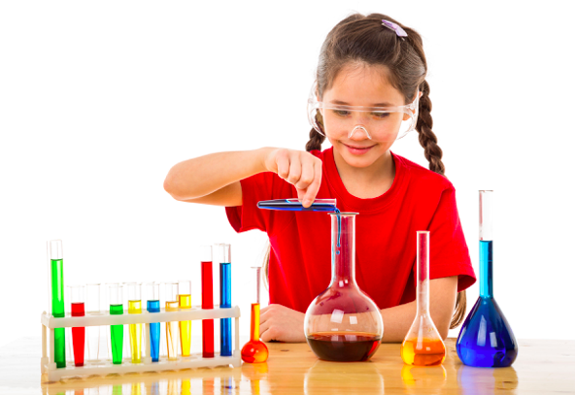
1.4 What Are Some Safety Rules in the Laboratory?
Why do we have to follow rules in laboratories?
Notes:
Lesson 3 (1 period; 40 minutes)
Lesson trigger
Ask students to mention some safety precautions when working in the laboratory.

Slide 27
1.4 What Are Some Safety Rules in the Laboratory?
At the end of this section, you should be able to answer the following questions:
What are some rules in the laboratory?
Why should we recognise the symbols of hazardous substances and know the proper ways of handling these substances?
Why should we observe safety rules at all times in the laboratory?
Notes:
Ask students where science experiments are carried out.
Are they carried out only in laboratories?
2. Ask students the questions shown to get them thinking about the safety rules to be observed in the laboratory.

Slide 28
1.4 What Are Some Safety Rules in the Laboratory?
General safety rules: What you should do
Open all doors and windows unless otherwise instructed by your teacher.
Read the instructions first and understand them before starting your experiment. If in doubt, always ask your teacher.
Handle all apparatus and chemicals carefully and correctly. Always check the label on the container before using the substance it contains.
Work tidily. Wash all used apparatus and dispose of the waste correctly.
Return the apparatus to the proper storage places after cleaning.
Wash your hands after all laboratory work.
Notes:
Go through these general safety rules with the students.

Slide 29
1.4 What Are Some Safety Rules in the Laboratory?
General safety rules: What you should NOT do
Do not enter the laboratory without your teacher’s permission.
Do not carry out any test or experiment without your teacher’s permission.
To avoid contamination, do not pour any unused chemical back into its container.
Do not taste any chemicals unless otherwise instructed by your teacher.
Do not eat, drink or play in the laboratory.
Do not tamper with the electrical mains and other fittings in the laboratory.
Do not remove any apparatus or chemicals from the laboratory.
Notes:
Go through these general safety rules with the students.

Slide 30
1.4 What Are Some Safety Rules in the Laboratory?
Specific safety rules: What you should do when heating or mixing chemicals
Wear goggles when mixing or heating chemicals.
Put flammable substances away from a flame.
When heating chemicals in a test tube, point the mouth of the test tube away from yourself and others.
Specific safety rules: What you should do when accidents occur
Report all accidents, injuries, breakage and spillage to your teacher immediately.
Should a chemical get into your mouth, spit it out into a basin and rinse your mouth with plenty of water. Report the incident to your teacher.
Notes:
Go through these specific safety rules with the students.
Guide students to carry Try It Out on Student Book p. 11.
In small groups, have students identify and discuss the dangers that may be present and what should be done to avoid them.

Slide 31
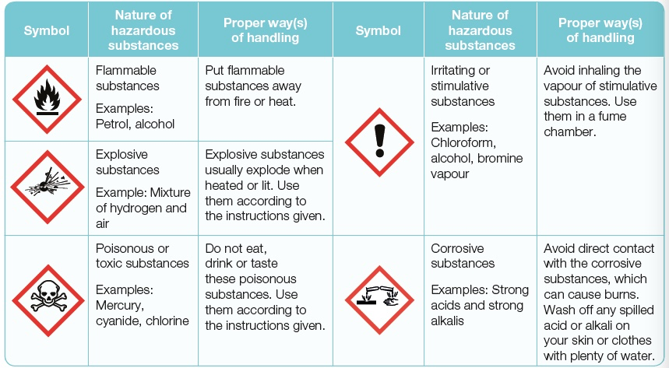
1.4 What Are Some Safety Rules in the Laboratory?
Why should hazardous substances be labelled?
Notes:
Highlight to students the importance of labelling hazardous substances.
Ask students to look at the five symbols of hazardous substances.
Discuss their nature and proper ways of handling them.
Go through the common symbols of hazardous substances and the type of substances they represent.
Guide students to carry out Activity 1.1 on Workbook pp. 1-2.
Enrichment for advanced students
Ask students to search for more symbols of hazardous substances on the Internet and the corresponding nature and proper ways of handling these substances.

Slide 32
1.4 What Are Some Safety Rules in the Laboratory?
Key Points
You should observe safety rules at all times in the laboratory.
You should recognise the symbols of hazardous substances and know the proper ways of handling these substances.
Notes:
Review the key points with students.

Slide 33
Chapter 1 Introducing Science
1.1 What Is Science?
1.2 What Are the Important Attitudes in Science?
1.3 What Are Skills and Processes in Science?
1.4 What Are Some Safety Rules in the Laboratory?
1.5 What Are Some Apparatus In the Laboratory?
1.6 Science and Technology

Slide 34
1.5 What Are Some Apparatus In the Laboratory?
At the end of this section, you should be able to answer the following questions:
What are some laboratory apparatus and their use?
Why do we need to know the purpose of the different laboratory apparatus?
Notes:
Lesson 4 (2 periods; 80 minutes)
Lesson trigger
Ask students the questions shown to get them thinking about the different kinds of laboratory apparatus.

Slide 35
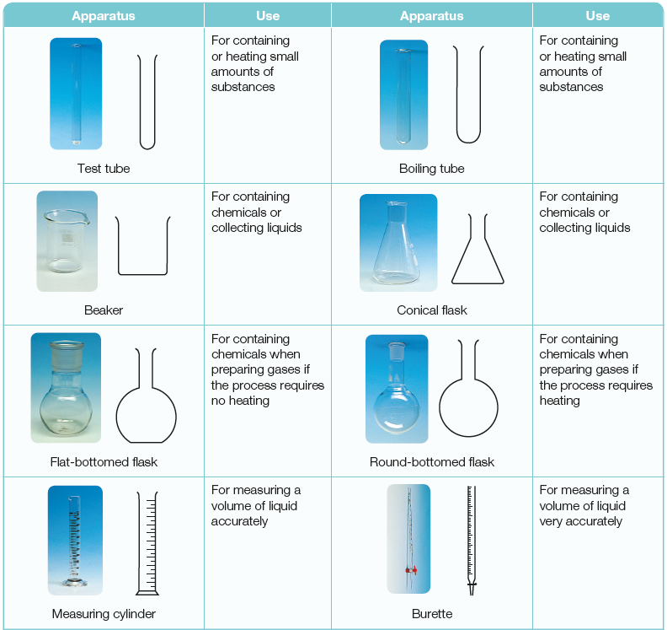
1.5 What Are Some Apparatus In the Laboratory?
Notes:
1. Go through the names of the apparatus, their sectional diagram and their function.
2. Highlight to students the more commonly used apparatus.

Slide 36
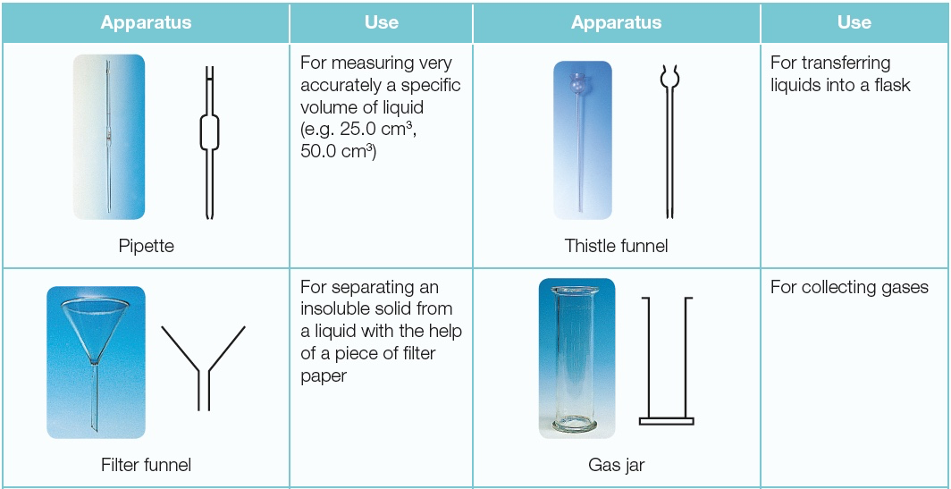
1.5 What Are Some Apparatus In the Laboratory?
Notes:
1. Go through the names of the apparatus, their sectional diagram and their function.
2. Highlight to students the more commonly used apparatus.

Slide 37
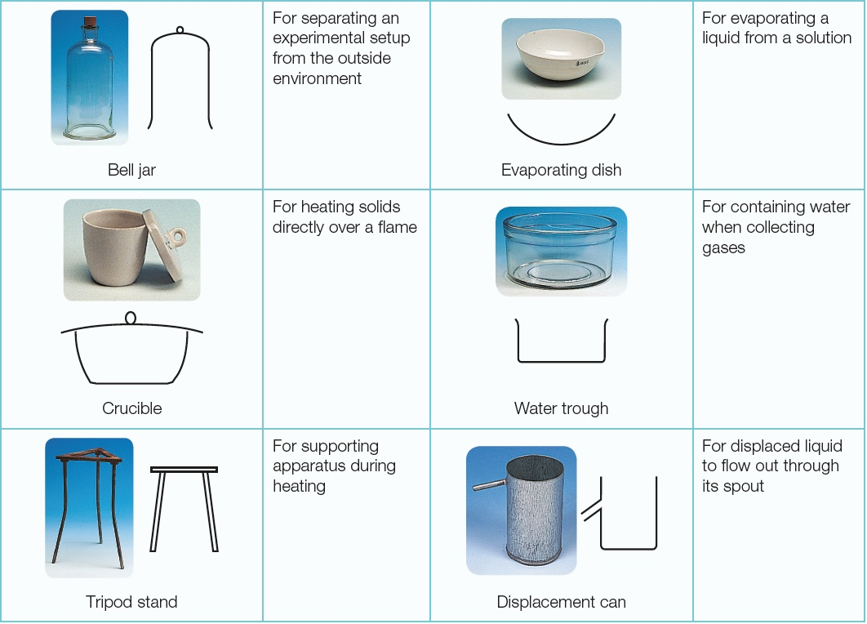
1.5 What Are Some Apparatus In the Laboratory?
Notes:
1. Go through the names of the apparatus, their sectional diagram and their function.
2. Highlight to students the more commonly used apparatus.

Slide 38
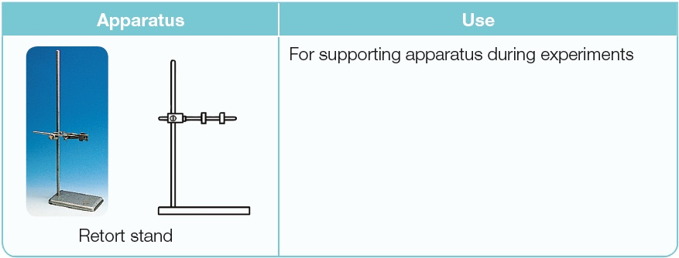
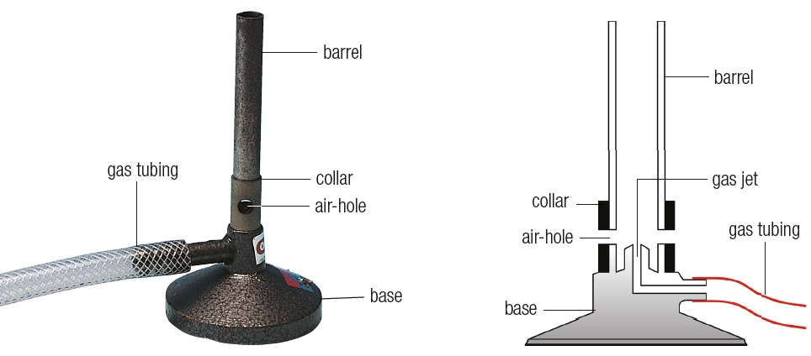
1.5 What Are Some Apparatus In the Laboratory?
Notes:
Go through the name of the apparatus, its sectional diagram and its function.
Guide students to carry out Activity 1.2 on Workbook pp. 3-5.
Ask students to identify the laboratory apparatus in Try It Out on Student Book p. 14.
Guide students to carry out Activity 1.3 on Workbook pp. 6-11.

Slide 39
1.5 What Are Some Apparatus In the Laboratory?
Key Points
Different types of laboratory apparatus are used for different purposes. The correct skill of handling these apparatus is important for safety reasons, and to get accurate and reliable results.
Laboratory apparatus should be drawn in outline only, and in their correct proportions.
Notes:
Review the key points with students.

Slide 40
Chapter 1 Introducing Science
1.1 What Is Science?
1.2 What Are the Important Attitudes in Science?
1.3 What Are Skills and Processes in Science?
1.4 What Are Some Safety Rules in the Laboratory?
1.5 What Are Some Apparatus In the Laboratory?
1.6 Science and Technology

Slide 41
1.6 Science and Technology
Science 🡪 studying the nature of matter
Technology 🡪 application of what is learnt about the nature of matter
Dolly, the first cloned mammal
Genetically modified maize
Notes:
Lesson 5 (1 period; 40 minutes)
Lesson trigger
Ask students to give examples of how science has helped make life easier for us.

Slide 42
1.6 Science and Technology
At the end of this section, you should be able to answer the following questions:
What are the benefits that science and technology bring us?
How can science and technology cause problems for us and the environment?
What are the limitations of science and technology?
Notes:
Ask students the questions shown to get them thinking about some benefits and limitations of science and technology.

Slide 43
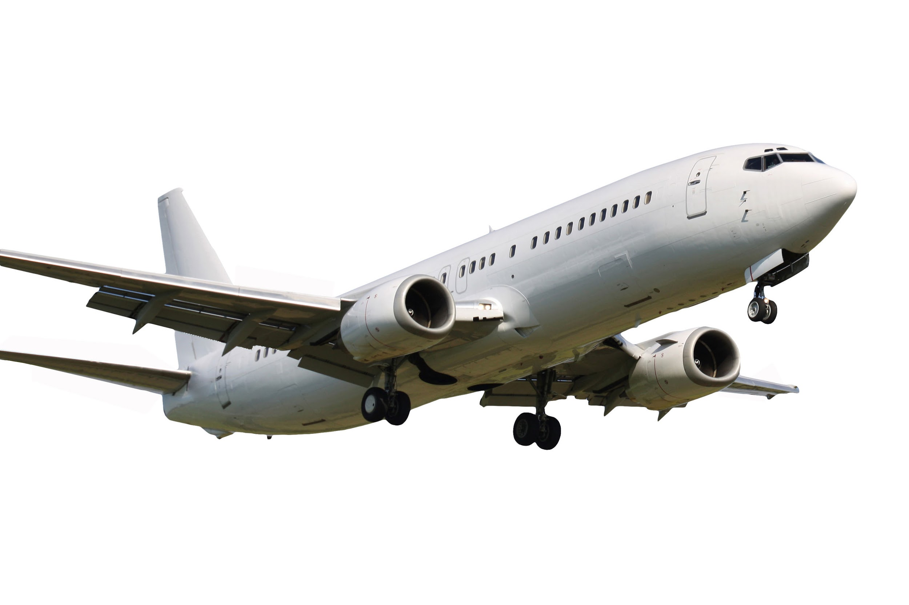
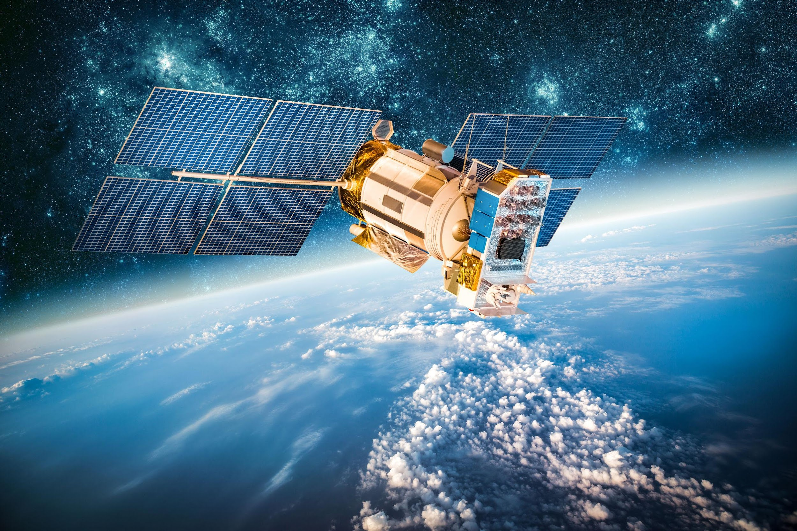
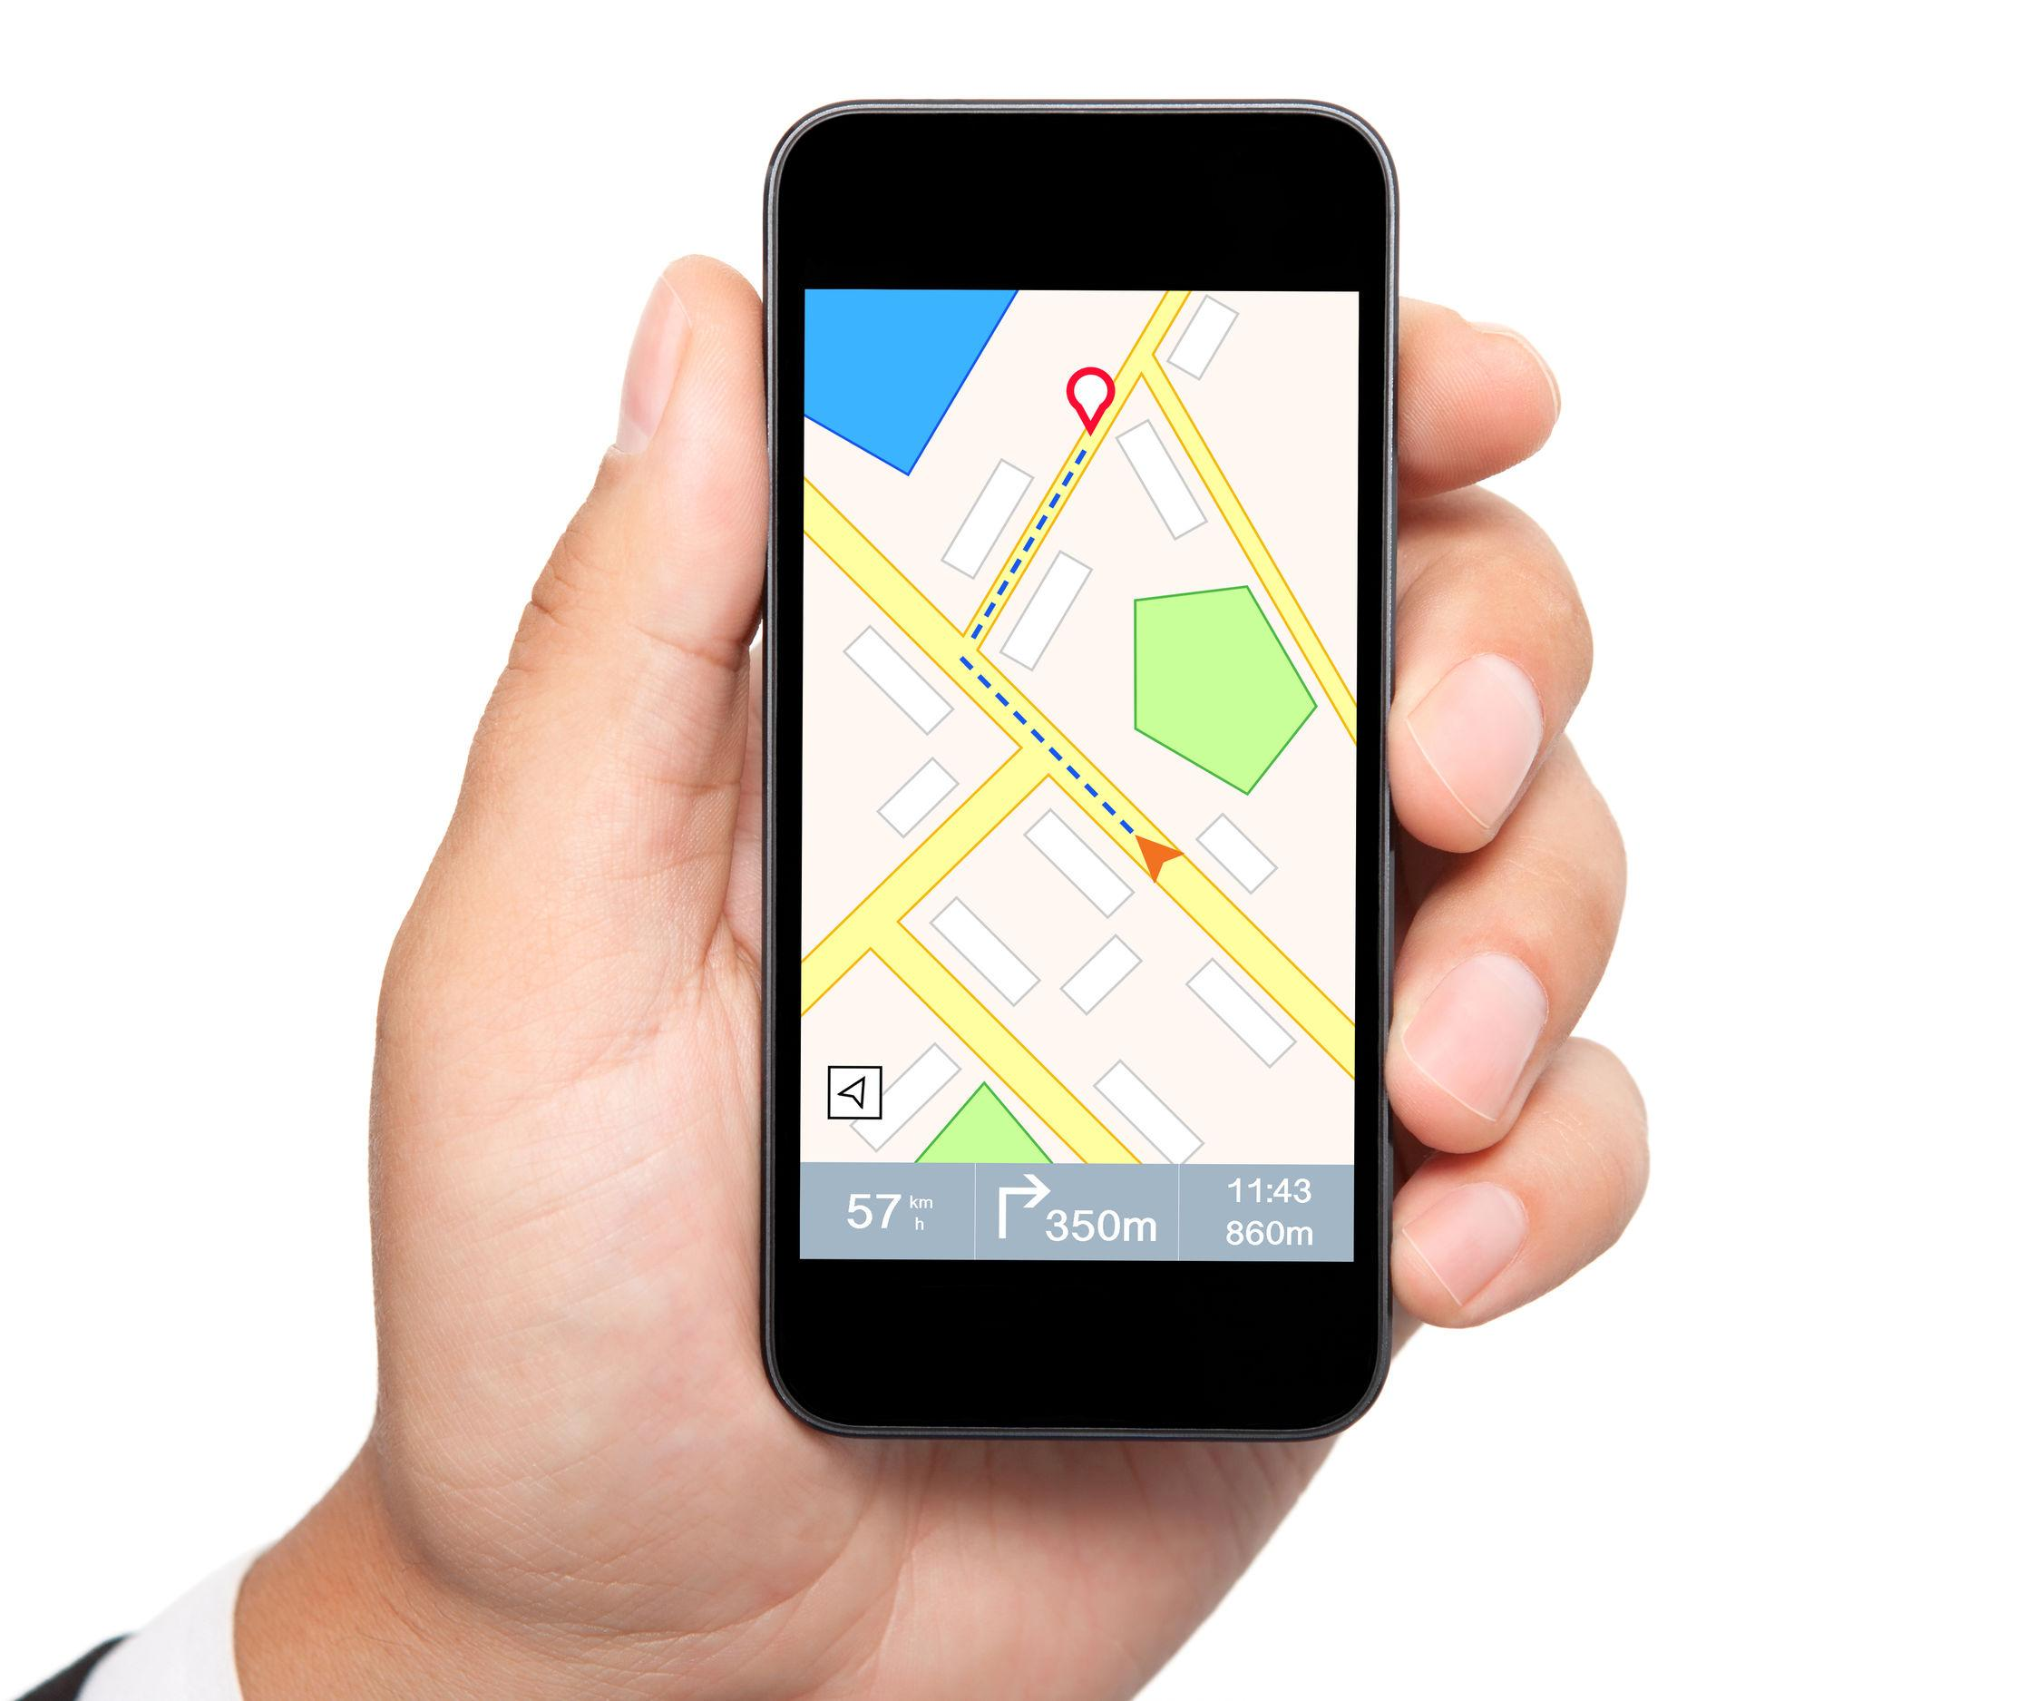

1.6 Science and Technology
Scientists and engineers apply what they learn in science to invent new products, processes and systems as well as to solve problems.
The use of ICT enables us to process very large amounts of data in research.
Notes:
Guide students to recognise that the application of scientific knowledge has resulted in many inventions and discoveries.
Ask students to name other inventions.
Ask students the following questions below:
How do you make use of ICT in your daily life?
What other types of technology do you make use of?
In groups of 3-4, ask students to discuss the questions in Think About It on Student Book p. 16.

Slide 44
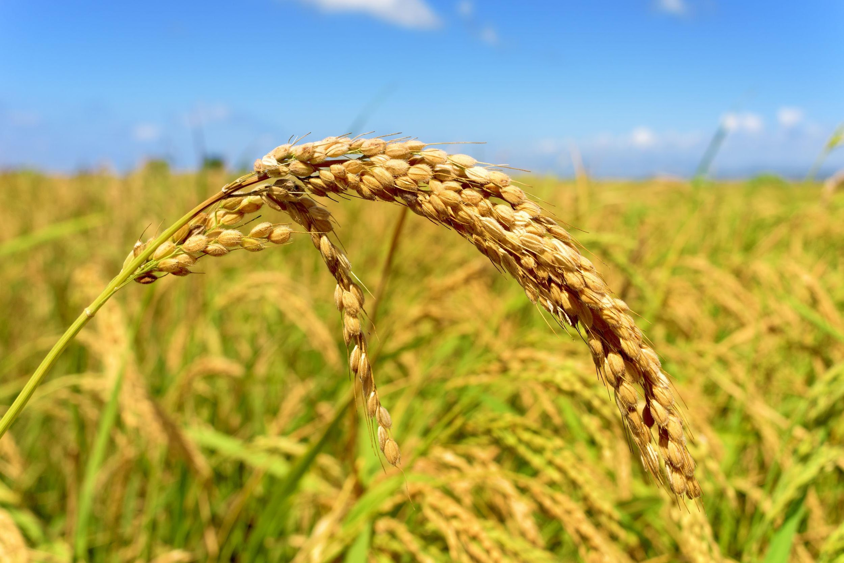
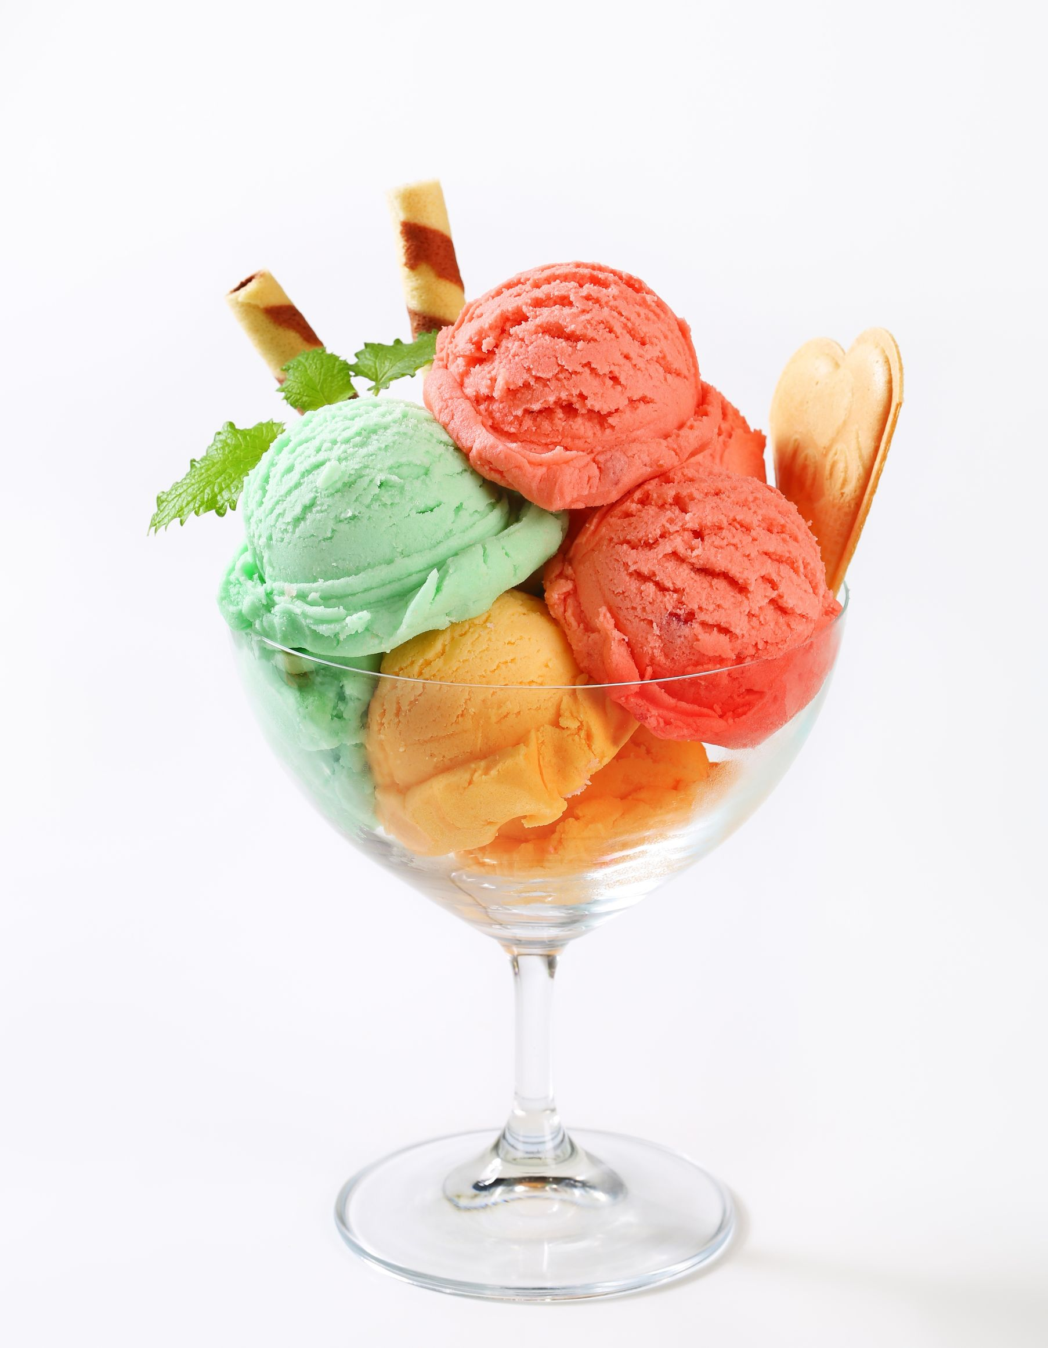
1.6 Science and Technology
Biotechnology enables us to grow high-yield rice plants that can produce greater quantities of rice grains.
APPLICATIONS OF SCIENCE AND TECHNOLOGY
Food technology enables us to have different flavours and colours of food.
Notes:
Go through the benefits that science and technology have brought to man.
Ask students to give some examples of gene-edited crops that have been created and the purpose they were created for.
Go through the benefits that science and technology have brought to man.
Ask students to give some examples of the use of food technology.

Slide 45
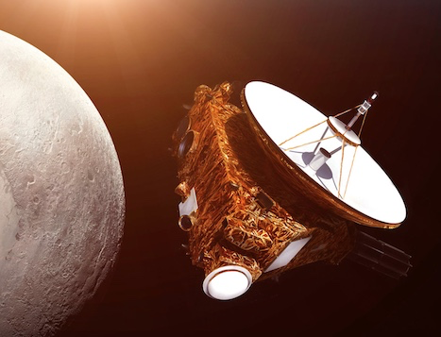
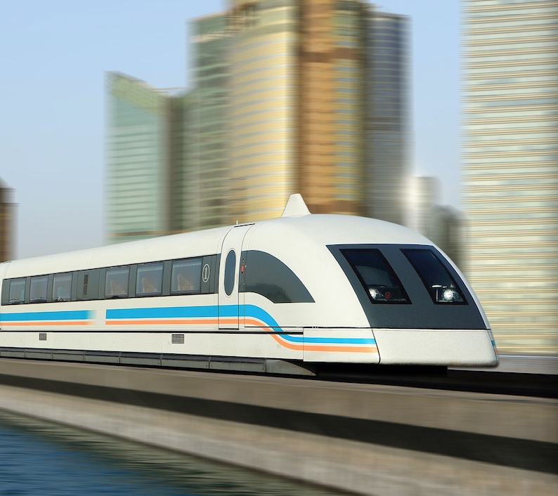
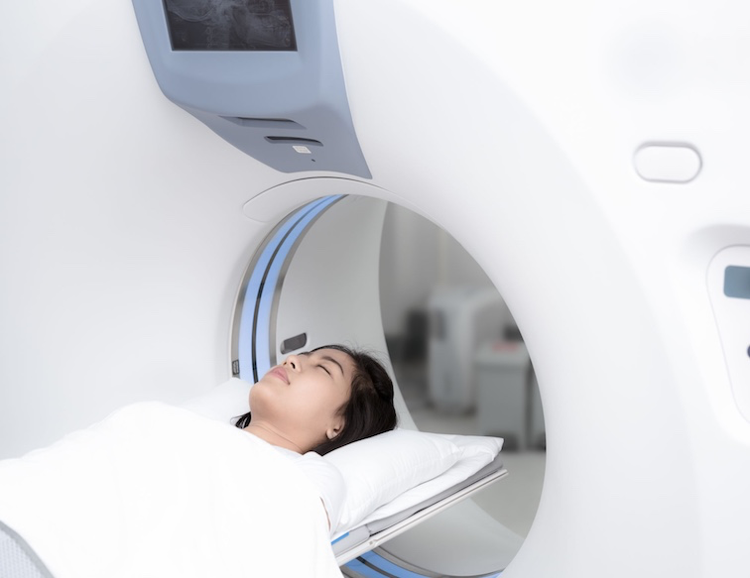
1.6 Science and Technology
Rail technology enables trains to transport passengers and goods over long distances quickly.
Space technology enables us to explore and find out more about outer space.
APPLICATIONS OF SCIENCE AND TECHNOLOGY
Medical technology enables us to prevent, diagnose, treat or cure diseases so that we can live longer and healthier.
Notes:
Go through the benefits that science and technology have brought to man.
Ask students to give some examples of what we have learnt through space exploration.
Ask students to give some examples of diseases that used to be incurable but now have a cure due to advancement of medical technology.
Ask students to give some examples of how advancements in science have helped make transportation systems better.

Slide 46
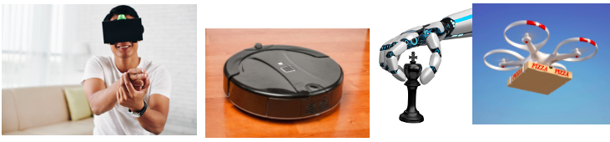

1.6 Science and Technology
Artificial Intelligence
Abuse and misuse of Science and Technology
Notes:
Ask students if they have seen the forms of technology shown on the slide.
Explain that these are some examples of artificial intelligence (AI).
Ask students to give examples of where AI is applied in real life.
How do you use AI in your daily life?
What do you wish AI could do for you?
Ask students to describe the pictures shown.
Lead them to recognise that although science and technology has brought mankind great benefits, it is also abused and misused.
Ask students to identify other examples of abuse and misuse of science and technology.
Ask students to discuss in small groups the question in Think About It on Student Book p. 18.
Enrichment for advanced learners
Discuss with students some methods that the scientific community has put in place to ensure that science and technology is used for the benefit of mankind.
What limitations are there in a real-world situation?
Give some examples of misconduct in the scientific community.

Slide 47
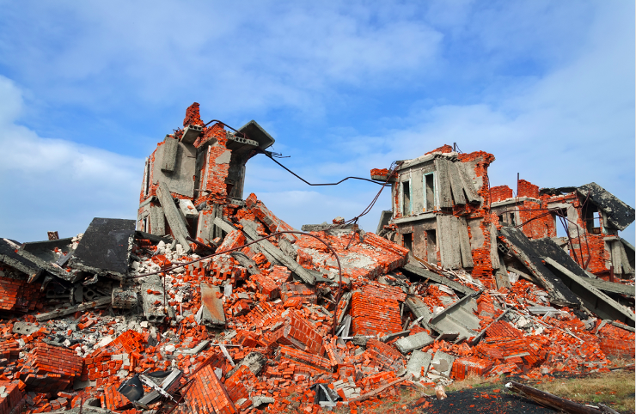
1.6 Science and Technology
Science and technology have their limitations. They cannot be used to find an answer to all our questions or solve problems.
We can use science and technology to reduce the damage caused by natural calamities, but we cannot prevent them from happening.
Notes:
Lead students to recognise the limitations of science and technology.
Guide students to recognise that science and technology is a double-edged sword.
Ask students to discuss in pairs the question in Think About It on Student Book p. 19.

Slide 48
1.6 Science and Technology
Key Points
Technology is the application of science.
Science and technology can bring us great benefits. However, abuse and misuse cause problems for us and the environment.
Science and technology have limitations.
Notes:
Review the key points with students.

Slide 49
Chapter 1 Introducing Science
Chapter review and extension
Reflection (Workbook page 12)
Review Questions (Student Book page 20)
Revision Worksheet 1 (Workbook pages 13–15)
Think-tank (Student Book page 21)
Notes:
Lesson 6 (1 period; 40 minutes)
Reflection
Have students complete the table in Reflection on Workbook p. 12. Ask them to revise the Student Book sections that they do not know well.
Formative assessment
Go through Review Questions on Student Book pp. 20 to test students’ understanding .
Ask students to complete Revision Worksheet 1 on Workbook pp. 13–15.
Extension
Have students attempt the questions in Think-tank on Student Book p. 21. Go through the answers with the class.

Slide 50
Acknowledgements
Slide 2, happy family © Wang Tom/123rf.com
Slide 7, butterfly on flower © Hayk Shalunts/123rf.com; Andromeda Galaxy © erq123/123rf.com; six jet plants with air trails © aspenrock/123rf.com; laboratory glassware © TAKSHI HONMA/123rf.com; Eagle Point – Grand Canyon West Rim © Rosana Scapinello/123rf.com
Slide 8, fresh lemons © Jakub Gojda/123rf.com; active joyful kids © midosemsem/123rf.com
Slide 17, cross sections of plant root © Puntasit Choksawadikom/123rf.com; steaming coffee cup © Georgii Dolgykh/123rf.com
Slide 18, plant © ifong/123rf.com
Slide 19, cute little black girl © Sergey Novikov/123rf.com; panda in the zoo © Zeng Xianglu/123rf.com
Slide 20, dangerous asphalt road with holes destroyed © Mikita Kavaliou/123rf.com
Slide 22, cute Indian boy thinking © Nikhil Patil/123rf.com
Slide 26, girl carrying out an experiment © Sergiy Bykhunenko/123rf.com
Slide 35, test tube © MCE/MCE; boiling tube © MCE/MCE
Slide 35, beaker © MCE/MCE; conical flask © MCE/MCE; burette © MCE/MCE; flat-bottomed flask © MCE/MCE; round-bottomed flask © MCE/MCE; measuring cylinder © MCE/MCE
Slide 36, pipette © MCE/MCE; thistle funnel © MCE/MCE; filter funnel © MCE/MCE; glass jar © MCE/MCE
Slide 37, bell jar © MCE/MCE; evaporating dish © MCE/MCE; crucible © MCE/MCE; water trough © MCE/MCE; tripod stand © MCE/MCE; displacement can © MCE/MCE
Slide 38, retort stand © MCE/MCE; Bunsen burner and its outline diagram © MCE/MCE
Slide 41, Dolly, the first cloned mammal © neverbutterfly/Wikipedia.com; maize © Inspirestock International – Exclusive Contributor/123rf.com
Slide 43, plane landing © rebius/123rf.com; space satellite orbiting Earth © Andrey Armyagov/123rf.com; interface navigator on a screen © prykhodov/123rf.com; computer with online shopping site © prykhodov/123rf.com
Slide 44, rice plant in a paddy field © nito500/123rf.com; scoops of fruit sherbet © tobi/123rf.com
Slide 45, New Horizons spacecraft at Pluto © Vadim Sadovski [Pluto – New horizons spacecraft. This image elements furnished by NASA.]/123rf.com; Asian lady on CT scan bed © Anek Suwannaphoom/123rf.com; Maglev train © cyoginan/123rf.com

Slide 51
Acknowledgements
Slide 46, young smiling man in VR goggles shooting © Dinish Tolipov/123rf.com; drone delivering pizza box © Milosh Kojadinovich/123rf.com; black robotic vacuum © krolfoto/123rf.com; humanoid robot hand with a king chessman © limbi007/123rf.com; powerful explosion of atomic bomb © Natalia Romanova/123rf.com; businessman looking at laptop © Wavebreak Media Ltd/123rf.com; man handprint showing stop cyberbullying © Milovan Paunic/123rf.com; heavy industrial coal powered electricity plant © Rudmer Zwerver/123rf.com
Slide 47, completely destroyed two-storey brick building © Андрей Радченко/123rf.com

